Slide 1
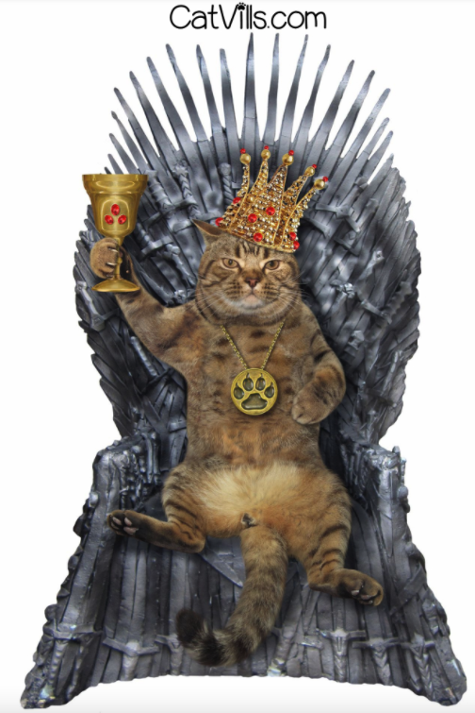
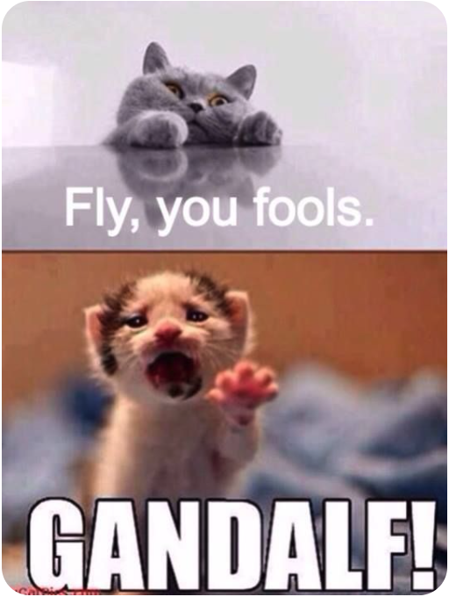
Project 3: GoT vs LOTR Subreddit NLP challenge
Game of Thrones
Lord of the Rings
By: Melissa McMillan
Jan 22, 2021

Slide 2
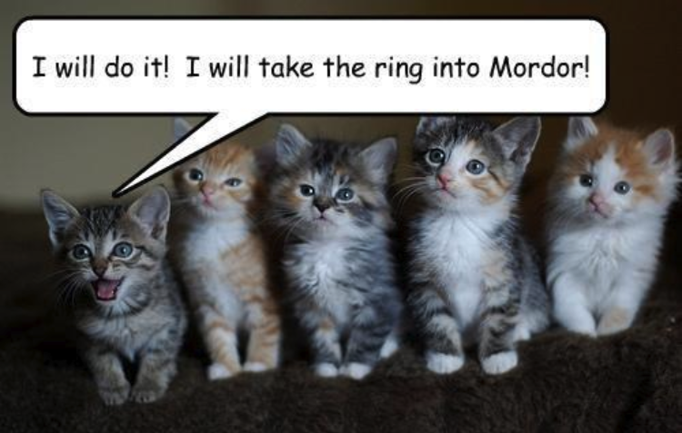
Outline
Problem statement
Data Collection
Eda & Cleaning
Naïve bayes modelling results
Random forest modelling results
Conclusions & Recommendations

Slide 3
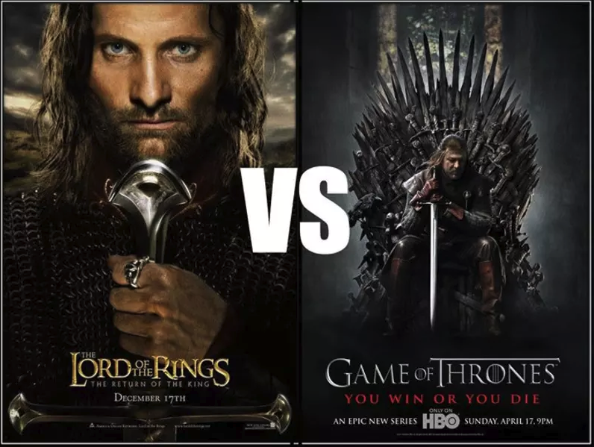
Problem statement
main got subreddit moderator needs to filter lotr posts out of her beautiful, pristine subreddit page
Can I develop a model to make her life easier?
Models: Naïve Bayes, Random Forest Classifier
Key metrics: Accuracy & Sensitivity
Notes:
The key metrics I want to use are accuracy score of my model, and then sensitivity/recall because I have assigned 1 to be for GOT since we want to keep those, and 0 for LOTR. So, we want to minimize our false negatives so that we don’t make our GoT reddit users upset because we accidentally filtered them out.

Slide 4


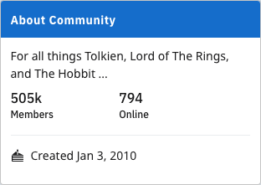
Data Collection: r/Got and r/lotr
Used pushshift’s api
5,100 titles with descriptions from both subreddits
10,200 total subreddit posts
Only used titles (not descriptions) in project

Slide 5
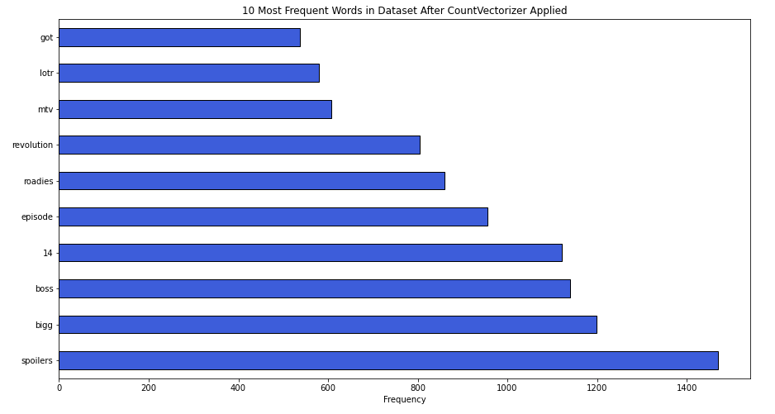
Eda & cleaning
Dropped post descriptions
Dropped nulls
Utilized regex tokenizer:
Removed emojis
Removed special characters
Removed symbols

Slide 6
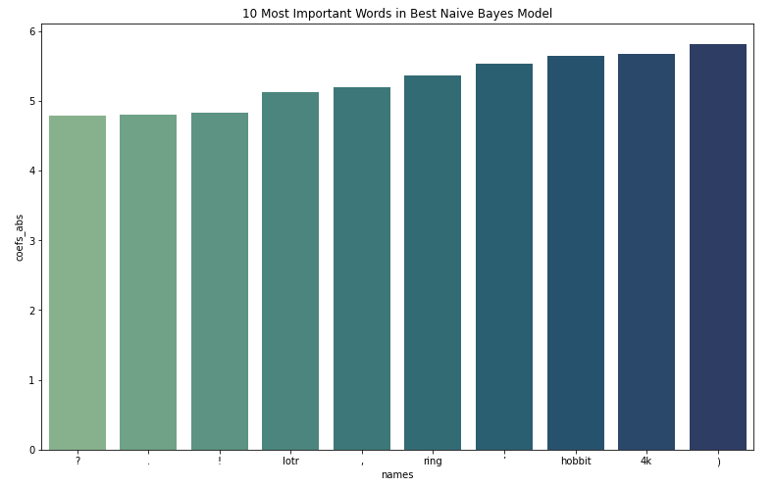
Naïve bayes model results
Best model:
Tfidf vectorizer w/ wordnet lemmatizer
Test score: 93%
Recall score = 0.89
Norm Fn = 11% (lowest of NB models)
Stop words = English
No max features
Nb alpha = 1.0
dirty data
Note: abs(importance)
Notes:
Ran 15 models, compared CountVectorizer to TfidfVectorizer, tried all kinds of hyperparameters between CountVectorizer, TfidfVectorizer, and NaiveBayes.

Slide 7
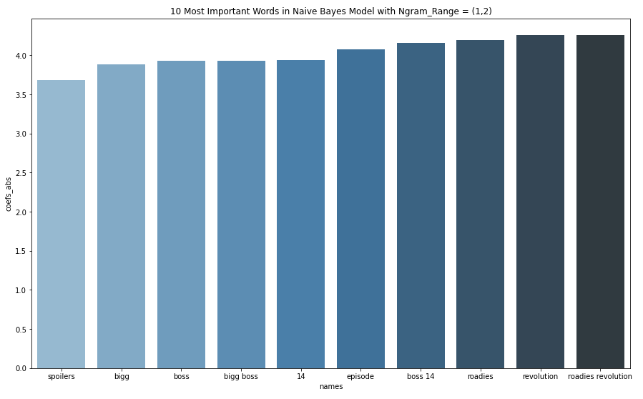
Naïve bayes model observation: winter is not coming
Experimented with ngram ranges (1, 2), (2,2), (1,3), (1,4), and (3,3)
Didn’t help my model much
Best ngram model was (1, 2)
Two-word features were barely in the top important features
Wordnet lemmatizer used here
Note: abs(importance)

Slide 8
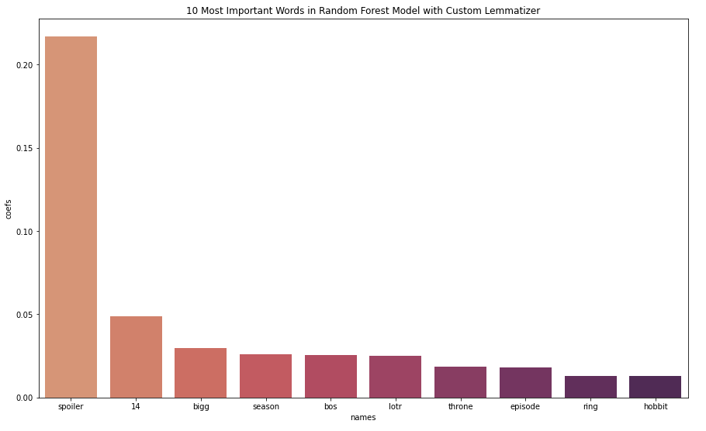
Random forest model results
Less overfitting
Used clean data
Best model:
Tfidfvectorizer w/ wordnet lemmatizer
Test score: 93%
Recall = .91
Norm FN = 9% (lowest of rf models)
Stop words = English
max features = 1000
Default random forest params
Notes:
Ran 5 different models, experimenting again with CountVectorizer, TfidfVectorizer, ngram ranges, stop word removal, tested all kinds of random forest classifier hyperparameters.

Slide 9
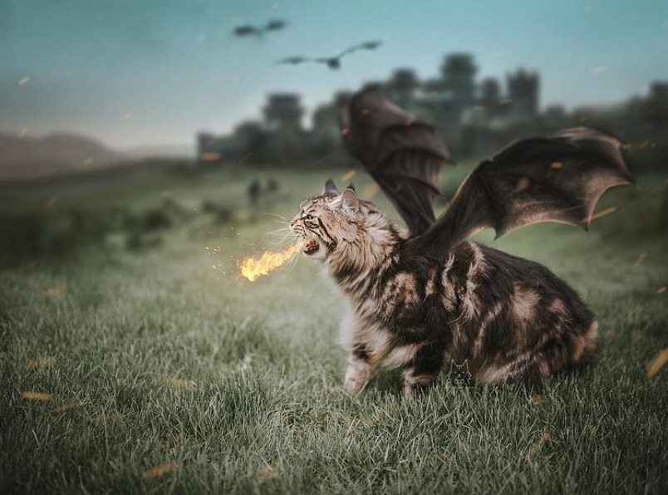
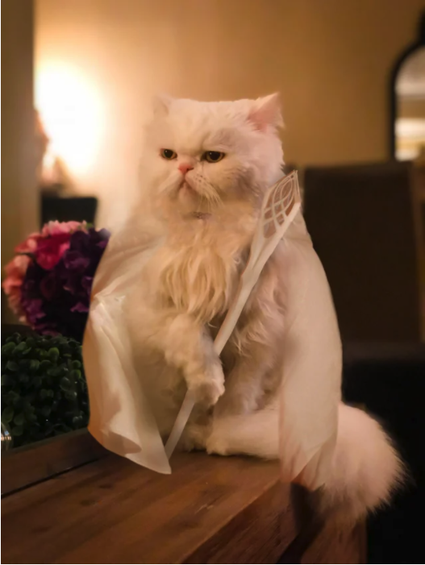
Conclusions/recommendations
Can delineate between subreddits with ~93-94% accuracy
Will need to do some data cleaning
Random forest is the preferred model (less overfitting)
Lemmatizers matter
The tfidf vectorizer with wordnet lemmatizer did best
Utilize stop words, max features
Future Work:
Incorporate more types of models
Utilize the Roc-Auc score to evaluate sensitivity
Sentiment Analysis on each type of subreddit

Slide 10
Image References (Ordered by when they appear)
https://do816.com/events/2018/4/13/lord-of-the-rings-vs-game-of-thrones
https://www.reddit.com/r/gameofthrones/
https://imgur.com/gallery/D4Ncyvd/comment/189944230?nc=1
https://www.reddit.com/r/lor/
https://catvills.com/game-of-thrones-cat-names/
https://www.pinterest.com/pin/179229260144682544/
https://www.reddit.com/r/lotr/comments/jzglqz/meet_my_cat_the_white_wizard
https://www.popsugar.com/family/Game-Thrones-Cats-46082964

